Slide 1

Data Analysis Report for Fond Rouge
Chan (Caiyi) Zhao, SAP
July 10, 2021

Slide 2
Agenda
Problem Identification
Counterfeit products and negative online reviews
Data Sources and Software
Identification of required data types and software for the analysis
Visualization and Insights
Understandings of the charts
Recommendation
Potential next steps

Slide 3


Problem Identification
Counterfeit
Affected Locations

Slide 4
Data Sources and Software
Data Sources
All sales transaction
Sentiment score (NPS + social sentiment score)
All returns of products
Software
SAP Analytics Cloud

Slide 5

Visualization and Insights

Slide 6
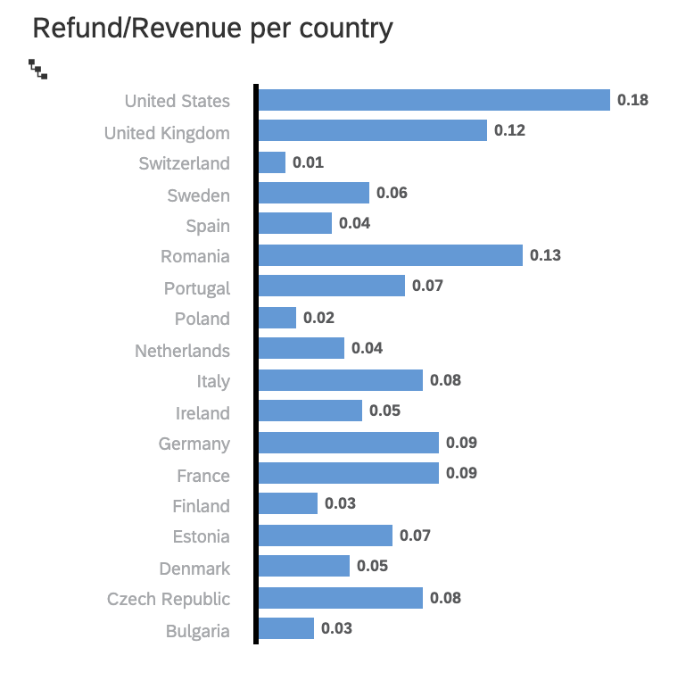
1. Which country(s) loses the highest percentage of revenue due to the returns?
The US loses the most from returns

Slide 7
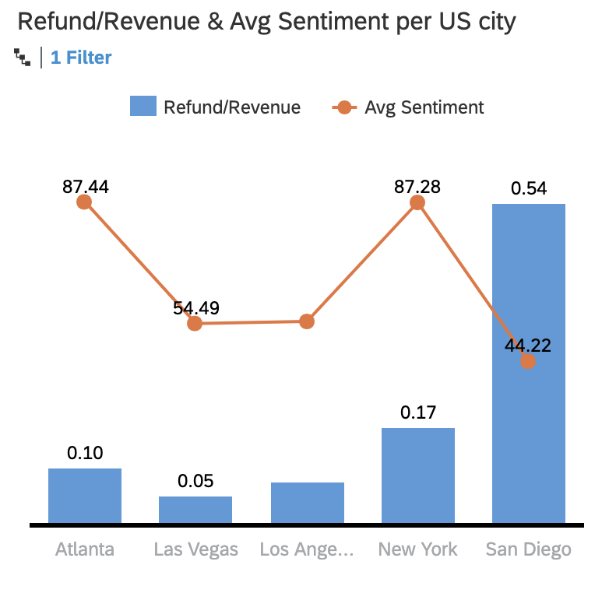
2. Which city(s) of the US loses the highest percentage of revenue due to the returns?
San Diego has the highest return rate, 54%
55.03
0.07

Slide 8
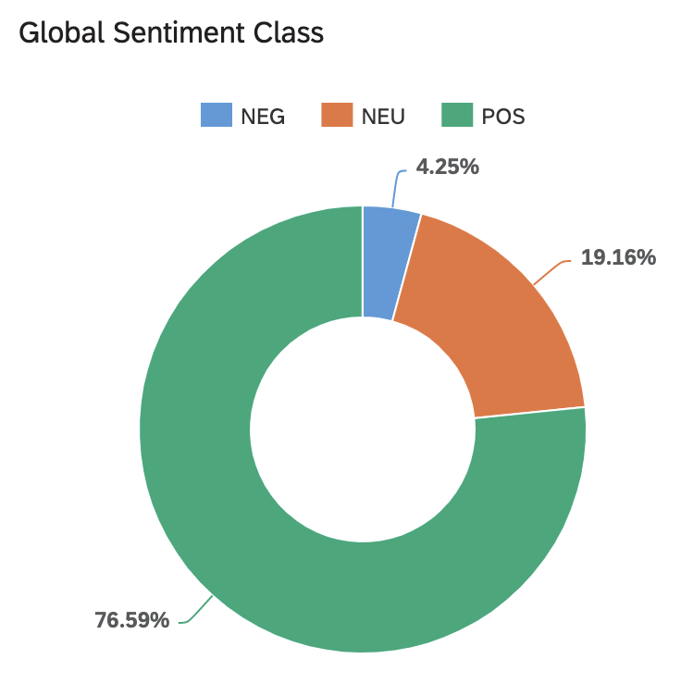
3. How do global customers perceive Fond Rouge?
Global customers overall negative sentiment
Global customers overall neutral sentiment
Global customers overall positive sentiment

Slide 9
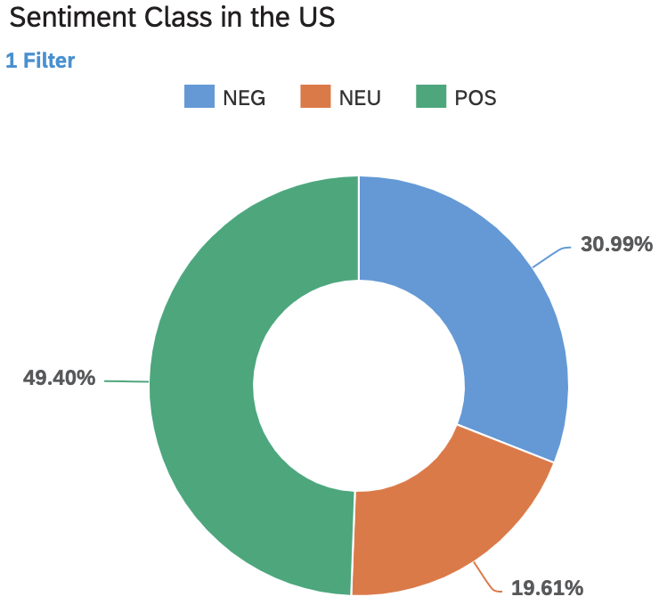
4. How do US customers perceive Fond Rouge?
US customers overall negative sentiment
US customers overall positive sentiment
US customers overall neutral sentiment

Slide 10
5. Which city(s) of the US has the counterfeit problem?
55.03
0.07
Low sentiment score and low return rate

Slide 11
6. Other problem: Loss from returns
San Diego: high refund/revenue ratio and low sentiment score
55.03
0.07

Slide 12



Conclusion & Recommendation
Counterfeit products appear in:
Las Vegas, Los Angeles
Big loss from returns
San Diego
Counterfeit because:
Poor actions against counterfeiters¹
Weak institutional efforts on law enforcement¹
Low customer awareness¹
Big loss from returns because:
Poor in-store service
Poor storage condition
Counterfeit issues next steps:
Legal department
Marketing department
Big loss from returns issues next steps:
In-store investigation
Storage condition investigation and plans to enhance the storage condition
Notes:
¹ Eser, Z., Kurtulmusoglu, B., Bicaksiz, A., & Sumer, S. I. (2015). Counterfeit supply chains. Procedia economics and finance, 23, 412-421.

Slide 13

Thank you.
Contact information: caiyi.zhao@outlook.com
Chan (Caiyi) Zhao
Data Analyst - SAP Technical Consulting Virtual Internship
Toronto, ON, Canada
(+1) 819 - 7123173

